Slide 1
Polynomial Interpolation
Numerical Counting Project 2020
Course instructor: Sir Adnan ullah khan
Class Id: 103745
Project members:
Muhammad Sharoz Raees(9852)
Kehkashan Akram(9825)

Slide 2
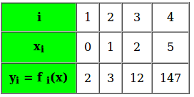
What is Interpolation? Interpolation is a method of finding new data points within the range of a discrete set of known data points. In other words interpolation is the technique to estimate the value of a mathematical function, for any intermediate value of the independent variable. For example, in the given table we’re given 4 set of discrete data points, for an unknown function f(x) :

Slide 3
What is interpolation:
The Lagrange interpolation formula is a way to find a polynomial which takes on certain values at arbitrary points.
Why we use Lagrange interpolation:
Lagrange interpolation gives you the unique polynomial of degree less or equal to n, which takes specified values at any n+1 given points. ... Of course for inverse interpolation we have to ensure that the function is injective (i.e. one-one) near the value of x being sought.

Slide 4
Formula of Interpolation:
Python libraries that we have use:
Numpy
Matplotlib

Slide 5
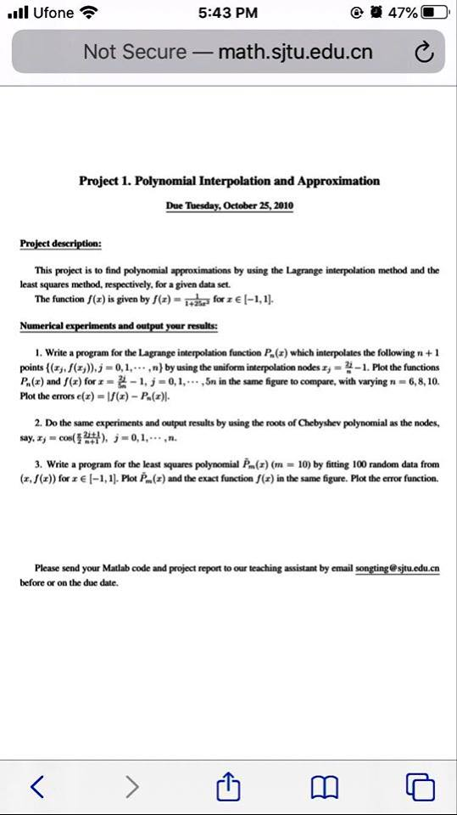

Slide 6
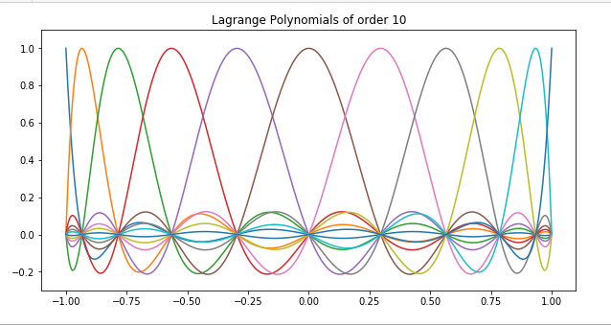
Output of Lagrange Polynomials of order 10:

Slide 7
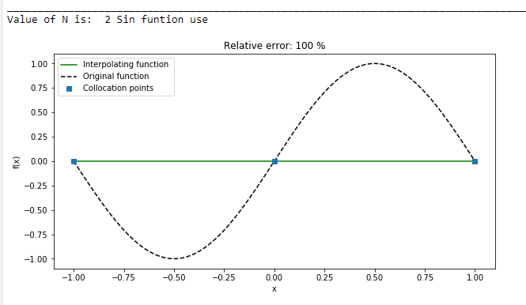
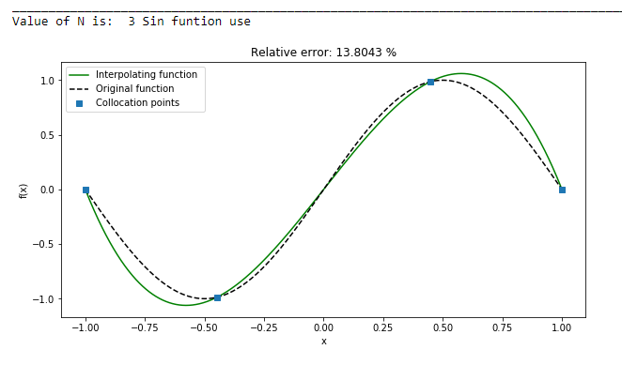
Output:
when we use sin()

Slide 8
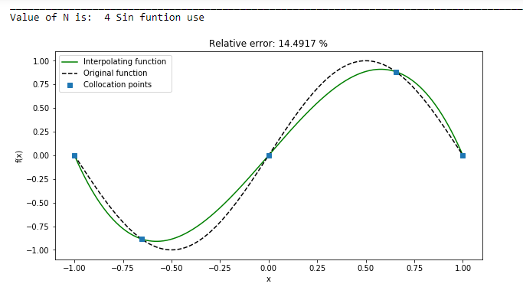
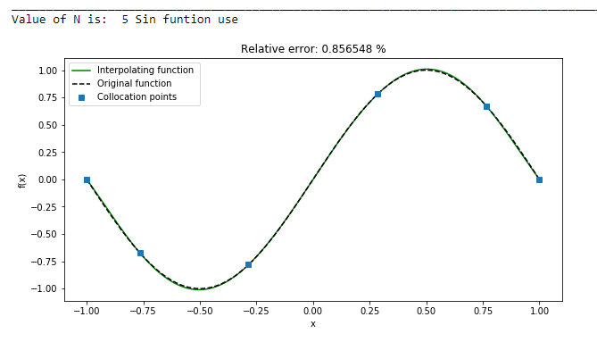
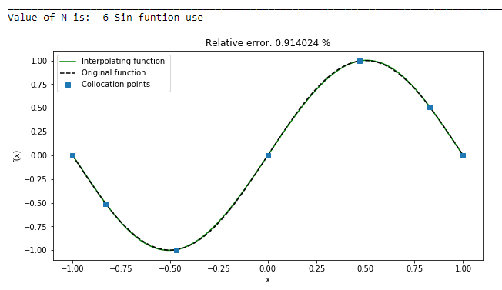
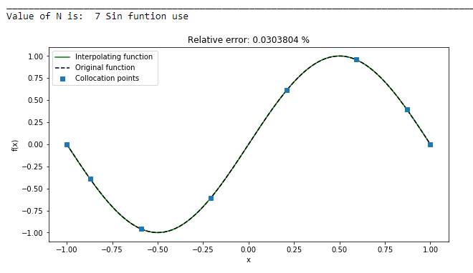

Slide 9
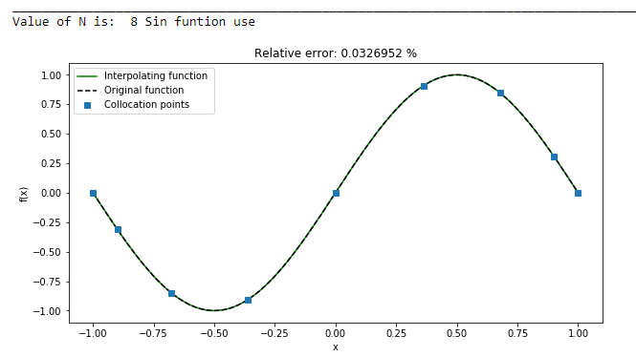
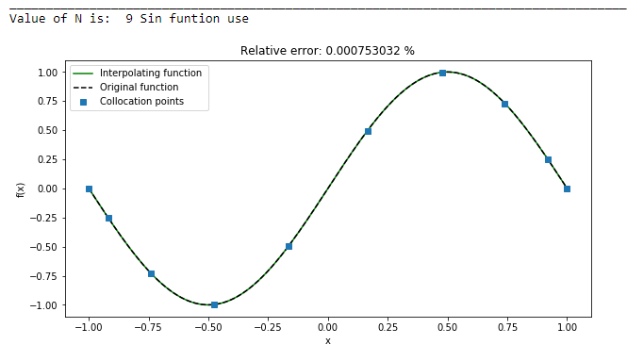
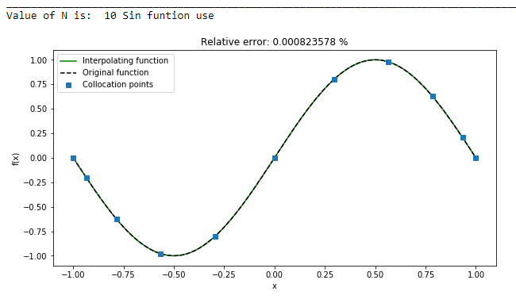
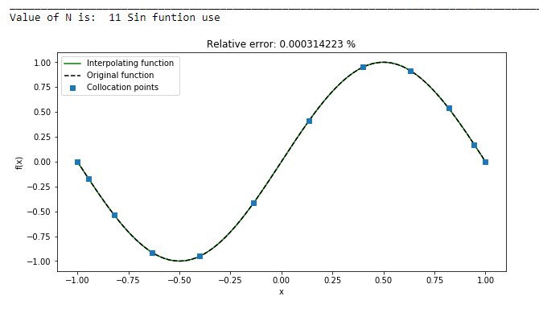
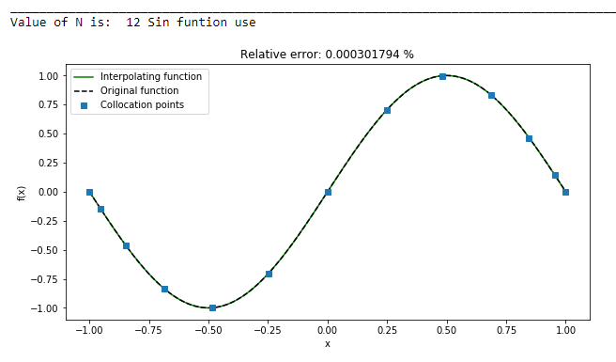

Slide 10
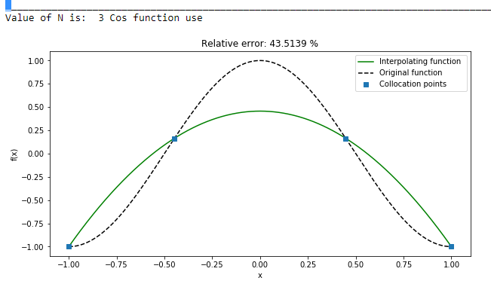
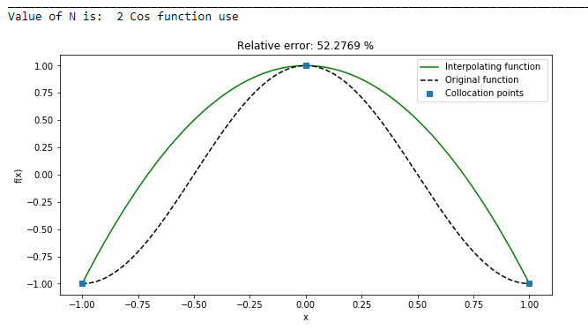
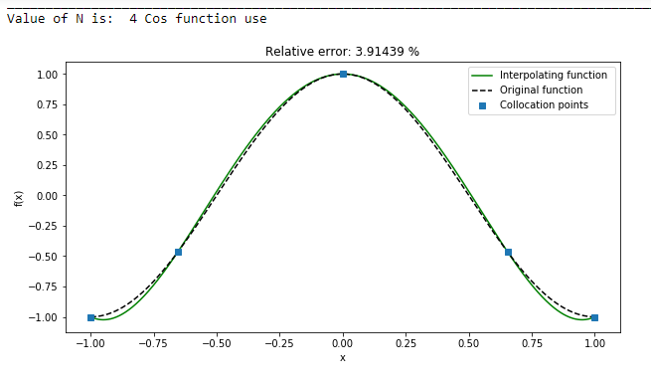
When we use Cos function

Slide 11
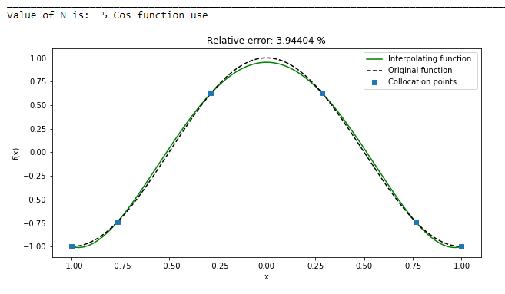
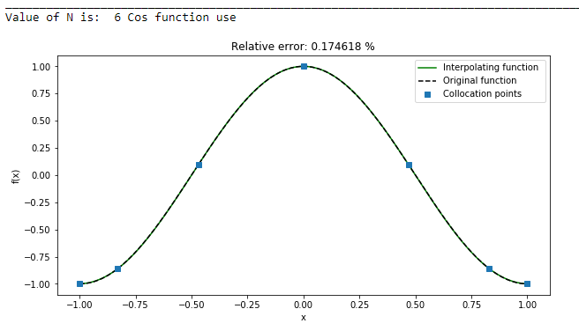
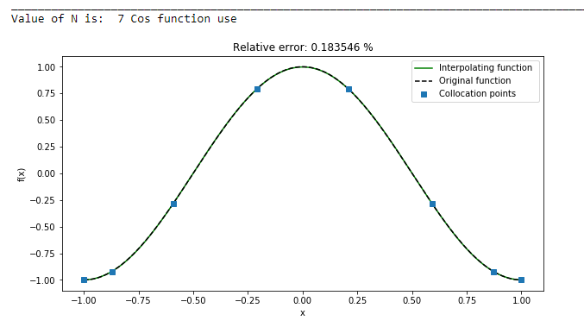
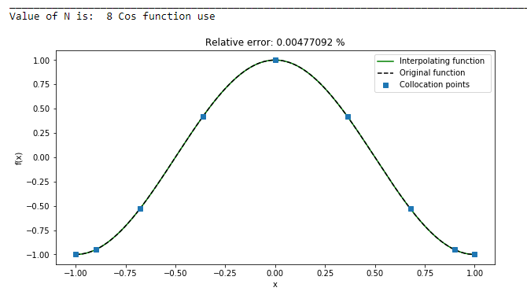

Slide 12
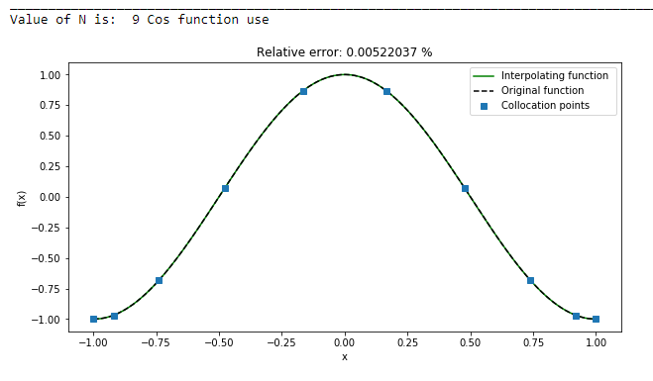
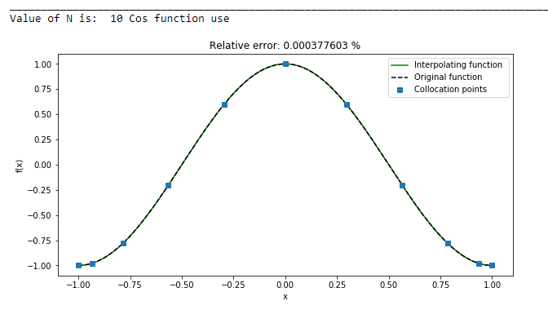
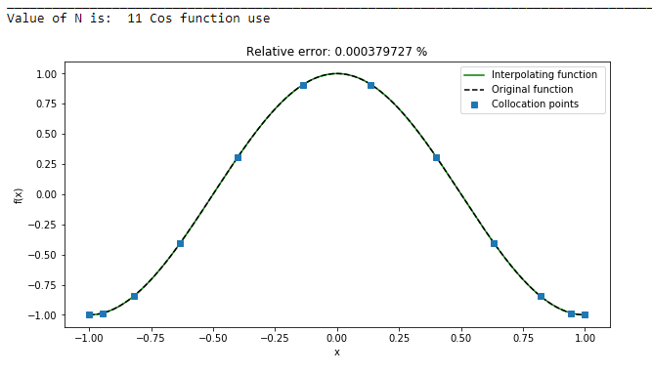
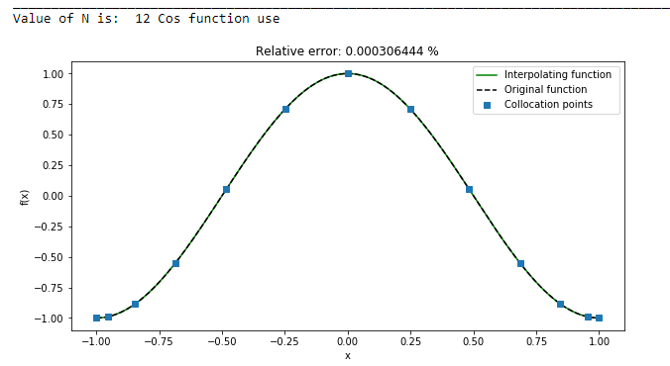

Slide 13
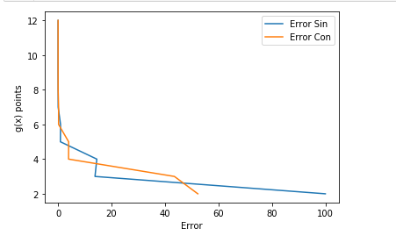
Comparation of Sin and Cos langrage interpolation output when xi belongs to from 2 to 12

